Slide 1

Exploring the Business Operations and Performance of Vrinda Store: An In-depth Analysis

Slide 2

Objectives:
Vrinda store wants to create an annual sales report for 2022.So that, Vrinda can understand their customers and grow more sales in 2023.

Slide 3

Problem Statement:
Compare the sales and orders using single chart.
Which month got the hishest sales and orders?
Who purchased are different more-men or women in 2022?
What are different order status in 2022?
List of top 5 states contributing to the sales.
Relation between age and gender based on number of orders.
Which channel is contributing to maximum sales
Highest selling category ?

Slide 4
Comparation of sales and orders
Row Labels | Sum of Amount | Count of Order ID
Jan | 1820601 | 2702
Feb | 1875932 | 2750
Mar | 1928066 | 2819
Apr | 1829263 | 2685
May | 1797822 | 2617
Jun | 1750966 | 2597
Jul | 1772300 | 2579
Aug | 1808505 | 2617
Sep | 1688871 | 2490
Oct | 1666662 | 2424
Nov | 1615356 | 2383
Dec | 1622033 | 2384

Slide 5
Comparation of sales between men and women
Row Labels | Sum of Amount
Men | 7613604
Women | 13562773

Slide 6
Orders Status Analysis
Row Labels | Count of Order ID
Cancelled | 844
Delivered | 28641
Refunded | 517
Returned | 1045

Slide 7
Top 5 States
Row Labels | Sum of Amount
MAHARASHTRA | 2990221
KARNATAKA | 2646358
UTTAR PRADESH | 2104659
TELANGANA | 1712439
TAMIL NADU | 1678877

Slide 8
Number of orders based on Age & Gender
Count of Order ID | Column Labels
Row Labels | Men | Women
Adult | 15.47% | 34.59%
Senior | 5.91% | 13.70%
Teenager | 9.20% | 21.13%

Slide 9
Channel Distribution As per sales
Row Labels | Count of Order ID
Ajio | 6.2%
Amazon | 35.5%
Flipkart | 21.6%
Meesho | 4.5%
Myntra | 23.4%
Nalli | 4.8%
Others | 4.1%

Slide 10
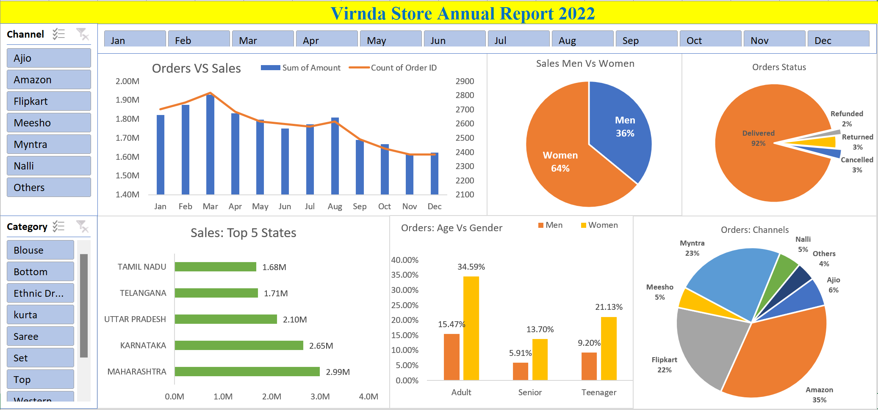
Dashboard of Vrinda Store Report 2022

Slide 11

Project Insights
Women are more likely to buy as compared to men (~64%).
Maharashtra, Karnataka and Uttar Pradesh are the top 3 states(~35%).
Adult age group (30-49 yrs) is max contributing(~50%).
Amazon, Flipkart and Myntra channels are max contributing (~80%).

Slide 12

Final Conclusion to Improve Vrinda store sales:
Target women customers of age group (30-49 yrs) living in Maharashtra, Karnataka and Uttar Pradesh by showing ads/offers/coupons available on Amazon, Flipkart and Myntra.

Slide 13


Slide 14


